Slide 1
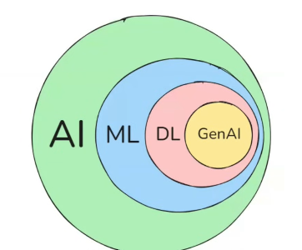

π
Rag
Langgraph
Notes:
Content: https://www.linkedin.com/pulse/chunking-strategies-ai-data-kash-kashyap-0lghe/

Slide 2
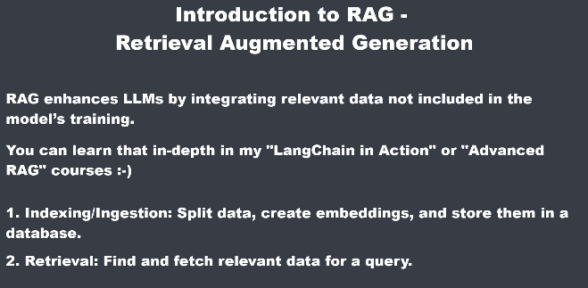
Retrieval Augmented Generation
Title: Introduction to RAG – Retrieval Augmented Generation
Main Idea: RAG enhances LLMs by integrating relevant data not included in the model’s training.
Additional Note: You can learn that in-depth in my “LangChain in Action” or “Advanced RAG” courses 🙂
Step 1 in the RAG Process:
Indexing/Ingestion: Split data, create embeddings, and store them in a database.
Notes:
Content: https://www.linkedin.com/pulse/chunking-strategies-ai-data-kash-kashyap-0lghe/

Slide 3
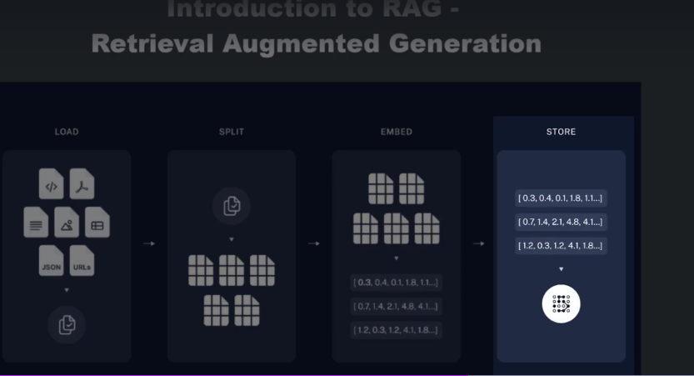
In the indexing stage, we load raw data and split it into smaller chunks.
These chunks are parsed through an embedding model to create vectors that represent the semantic meaning of the chunk.
The embeddings along with the chunks are then stored into a vector database.
Notes:
Content: https://www.linkedin.com/pulse/chunking-strategies-ai-data-kash-kashyap-0lghe/

Slide 4
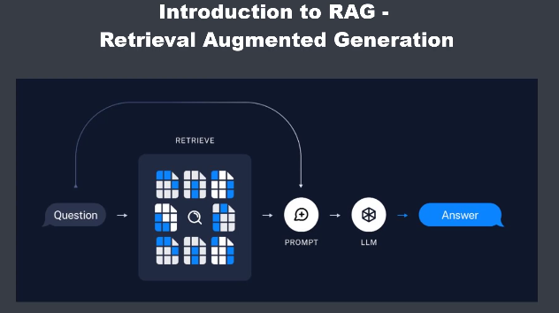
The retrieval stage begins with a user question.
This question is embedded into a vector, which is then matched against the vector database to find the most relevant chunks.
The retrieved chunks are combined with the original query of the user to form a prompt, which is then sent to the language model.
The model processes all of this information and generates a well-informed human like response.
Notes:
Content: https://www.linkedin.com/pulse/chunking-strategies-ai-data-kash-kashyap-0lghe/

Slide 5
import os
from dotenv import load_dotenv, find_dotenv
from langchain_openai import AzureOpenAIEmbeddings, AzureChatOpenAI
from langchain_chroma import Chroma
from langchain_core.documents import Document
load_dotenv(find_dotenv(), override=True)
ENDPOINT_URL = os.getenv("ENDPOINT_URL")
AZURE_OPENAI_API_KEY = os.getenv("AZURE_OPENAI_API_KEY")
api_version = "2025-01-01-preview"
EMBEDDING_ENDPOINT_URL = os.getenv("EMBEDDING_ENDPOINT_URL")
EMBEDDING_AZURE_OPENAI_API_KEY = os.getenv("EMBEDDING_AZURE_OPENAI_API_KEY")
llm = AzureChatOpenAI(azure_endpoint=ENDPOINT_URL, api_key=AZURE_OPENAI_API_KEY, api_version=api_version)
embedding = AzureOpenAIEmbeddings(azure_endpoint=EMBEDDING_ENDPOINT_URL,
api_key=EMBEDDING_AZURE_OPENAI_API_KEY,
model="text-embedding-ada-002")
docs = [ Document(page_content="thi is india", metadata={"source": "a.txt"}),
Document(page_content="thi is japan", metadata={"source": "b.txt"}) ]
vectorstore = Chroma(embedding_function=embedding, collection_name="test_collection", persist_directory="./chroma_db")
vectorstore.add_documents(docs)
results = vectorstore.similarity_search("japan", k=6)
results = vectorstore.as_retriever()
Chroma Vectorstore
Notes:
Content: https://www.linkedin.com/pulse/chunking-strategies-ai-data-kash-kashyap-0lghe/

Slide 6
Notes:
Content: https://www.linkedin.com/pulse/chunking-strategies-ai-data-kash-kashyap-0lghe/

Slide 7
Notes:
Content: https://www.linkedin.com/pulse/chunking-strategies-ai-data-kash-kashyap-0lghe/

Slide 8
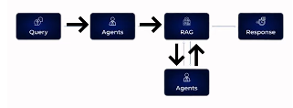
Agentic Rag
Rag - Hi I am rag ,I retrieve information fro external sources and deliver it to AI for Answer

Slide 9
Argentic Rag
It incorporates AI agents into the RAG pipeline to orchestrate its components and perform additional actions beyond simple information retrieval and generation to overcome
Notes:
Content: https://www.linkedin.com/pulse/chunking-strategies-ai-data-kash-kashyap-0lghe/

Slide 10
Notes:
Content: https://www.linkedin.com/pulse/chunking-strategies-ai-data-kash-kashyap-0lghe/

